Slide 1



BANK OF BARODA HACKaTHON -2022 TEAM NAME : tech bankers
Mentors:
Dr. B.Meenakshi Sundaram Professor&PG head/EEE Mrs. V.S.Chitra AP/EEE Mrs. M.Sivaramaselvi AP/EEE
TEAM MEMBERS:
RONALD G RICHARDS J
VARUN KUMARAN K
JOSHUA DELIGHTSON I

Slide 2
PROBLEM STATEMENT
Bank handles large volumes of cheques in the clearing process.
The process involves many technical verifications including signature verification. Some of these steps are manual and require human intervention to complete the process .
Their verification process and encryption methods got old and easily cloneable . We need new type of process for now a days .
The current process requires the high human capital deployment and longer processing time

Slide 3
EMPLOYEE’S Feedback
Bank employees are also feel this system is pretty out dated and takes a lot of time in the processing .
In case of the cheque scams happening in nowadays we need to update this system.
Their main challenge is to identify the cheques originality, but the fake is made as accurate to original.
Customer verification is not taking place if the amount is below 50,000 rupees.
Employees have to do a big task for a single cheque clearance .

Slide 4
EXISTING METHODS
Machines using by banks
Hp danni
Canon CR series
Manual verification of cheque by bank employees

Slide 5
TOOLS AND RESOURCES
A cheque scanner
UV light source
Printer
3D Printer
Internet
Soldering and basic electrical stuff
Raspberry pi
2D Barcode scanner

Slide 6
PROPOSED METHOD
Step 1
Cheque scanning with your light and gets verified
Cheque encryption with barcode and the key ( only the banks )
Cheque normal scanning and taking a soft copy
Getting the data in the cheques and applying on the server
Comparing the data of the domain in the cheque and in the database
Bank’s server recives the signal and transfer the money
After completing the verification send a signal to the banks ‘s server to realise the server
Step 2
Step 3

Slide 7
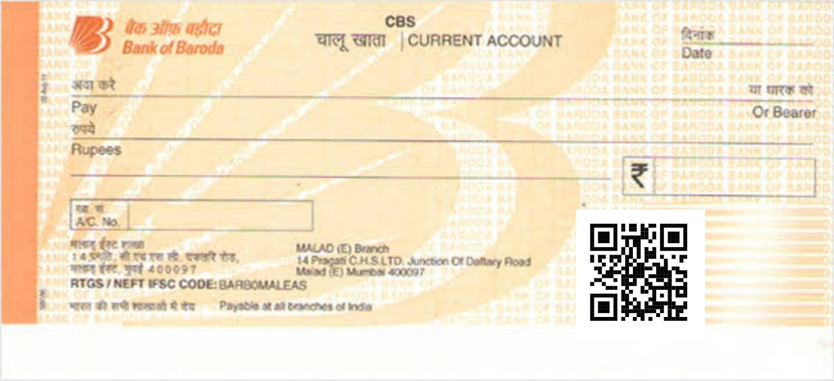
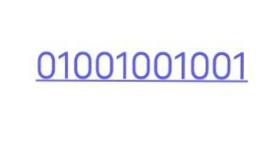

INNOVATION IN OUR PROJECT
New cheque encryption method:
In this method we are going to set a lock for the cheque through the QR code and encrypt with a key which only known by the bank .
🗝️ to this lock
(only known by the bank )
The key fill the space highlighted and the total encrypted data will unlock the access to the cheque
After the encryption is done the cheque will be moved to the next step of analyzing the data in the cheque, By this step we can avoid so many cheque frauds .

Slide 8
PROCESSES AFTER ENCRYPTION
After the encryption processes are over the scanner scans the cheque a by ICR and OCR.
We will analyze the information in the cheque like the account number, IFSC code , the amount and the signature etc.
These steps are fully done by the computer , it will verify those things with the data of the domain in the bank’s database .
But the overall process should be managed by a person , because it is fully automated so it can be fully hacked An human supervision can prevent these conditions.
The employee controls the ACM should lookover the process and complete the process by pressing the enter key.

Slide 9
Thank You

